Slide 1
Chat Server System

Slide 2
contents
Introduction to the problem
Problem Solutions
Methodology or Technology
Code
Results
Challenges
Future Goals
Conclusion

Slide 3
Problem statement
In today's digital era, real-time communication systems play a crucial role in personal and professional interactions.
However, creating an efficient and reliable chat system that supports multiple users simultaneously presents several challenges, including managing concurrent connections, enabling both broadcast and private messaging, and ensuring system performance under varying loads.
This project addresses these issues by developing a multi-client chat server system using socket programming and multithreading. The system leverages TCP/IP protocols for reliable communication and employs a user-friendly command-line interface for seamless interaction.
By focusing on networking and inter-process communication, the project provides a practical solution for real-time messaging needs.
3

Slide 4
Solutions
Client-Server Architecture:
Socket programming was used to create a centralized server that could oversee several clients at once and guarantee dependable TCP/IP connectivity.
1
Multithreading:
The server manages several client connections at once via multithreading, which enables smooth communication without preventing processes.
2
Message Features: To provide a variety of communication possibilities, the system allows private messaging for individual users as well as message broadcasting to all clients.
3
Error Handling:
To ensure system stability, strong error-handling procedures were incorporated to handle disconnected clients, invalid nicknames, and other possible problems.
4
Performance Monitoring:
To optimize resource management under pressure, the server tracks execution timings and keeps an eye on memory usage using the ‘psutil’ package.
5
User-Friendly Interface:
To improve usability, clients engage with the system using an easy-to-use command-line interface that includes features like nickname setting and unambiguous message commands.
6
4

Slide 5
Methodology
Multi-threading:
Multi-threading allows the server to handle multiple client connections simultaneously.
In order to maintain a responsive system, each thread is in charge of overseeing communication with a single client.
Race conditions are avoided when shared resources are accessed by using thread synchronization techniques like locks or mutexes.
5

Slide 6
Methodology
2. Inter- Process Communication:
IPC methods ensure effective message delivery by facilitating communication between threads or processes.
Although this system mostly employs sockets for communication, common IPC techniques include shared memory, pipelines, and message queues.
6

Slide 7
Methodology
3. TCP/IP Sockets:
IPC methods ensure effective message delivery by facilitating communication between threads or processes.
Although this system mostly employs sockets for communication, common IPC techniques include shared memory, pipelines, and message queues.
7

Slide 8
Technologies
Python
Socket programming
Multithreading
Psutil
Datetime
Command line interface(CFI)
8

Slide 9
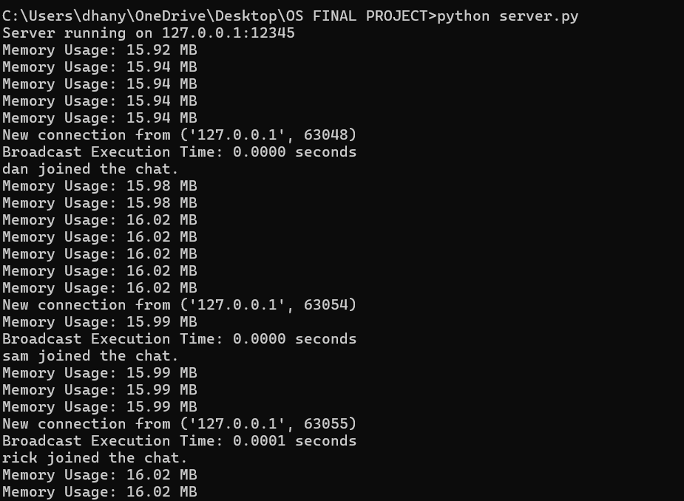
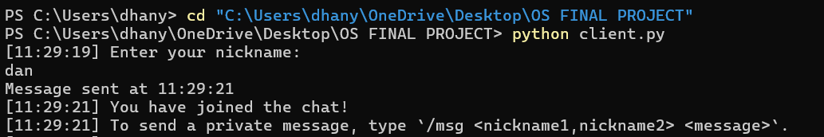
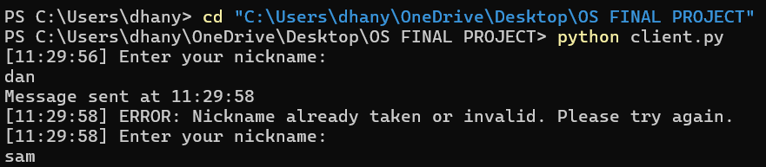



Results
10

Slide 10
Challenges
Managing multiple connections
Handling multiple client connections was challenging due to thread issues that caused the server to freeze or crash, requiring adjustments to endure stable performance.
Implementing private messaging
Setting up private messaging with the/msg command was complex, especially handling offline users and ensuring proper message routing.
Monitoring performance
Performance monitoring revealed inefficiencies in memory usage, prompting optimization of message processing to maintain server speed as clients increased.
Handling errors
Ensuring the system could handle unexpected events like client disconnections and invalid commands required error checks ad testing for stability.
11

Slide 11
Future Goals
Encryption:- Implement end-to-end encryption to secure messages and ensure privacy between user.
Authentication:- Introduce user authentication with login and password systems to prevent unauthorized access too the chat.
Group chart support:- Add functionality for users to create and join chat groups or channels for focused discussions.
Message history:- Enable storage and retrieval of past conversations, allowing users to view their message history.
Bot integration:- Integrate bots for automated tasks such as moderation, providing fun activities, or responding to common queries.
12

Slide 12
Conclusion
This project successfully implemented a real-time multi-client chat system using socket programming and multithreading.
The server efficiently handles multiple client connections, supporting message broadcasting, private messaging, and error management.
Multithreading allows concurrent task execution, enabling smooth message exchanges without blocking.
The user-friendly command-line interface simplifies client interaction, while server-side memory monitoring ensures optimal performance.
Future enhancements could include adding encryption, file transfer, and user authentication for a more secure and feature-rich system.
13

Slide 13
Thank You

